Slide 1

Performance Analysis of a Delay Constrained Data Offloading Scheme in an Integrated Cloud-Fog-Edge Computing System
Presented by Mohammad mahdi manafi
Dr. khorsandi

Slide 2
Outlines
Prerequisites
  Erlang’s Distribution
Introduction
  State the problems
  State the motivation
  State the solution approach
Related works
System models
  Edge subsystem analysis
  Fog subsystem analysis
  Cloud subsystem analysis
Problem formulation
Proposed Heuristic
Numerical results
Mohammad Mahdi Manafi

Slide 3
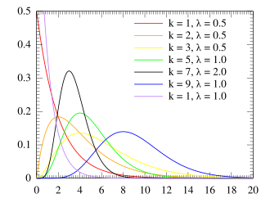
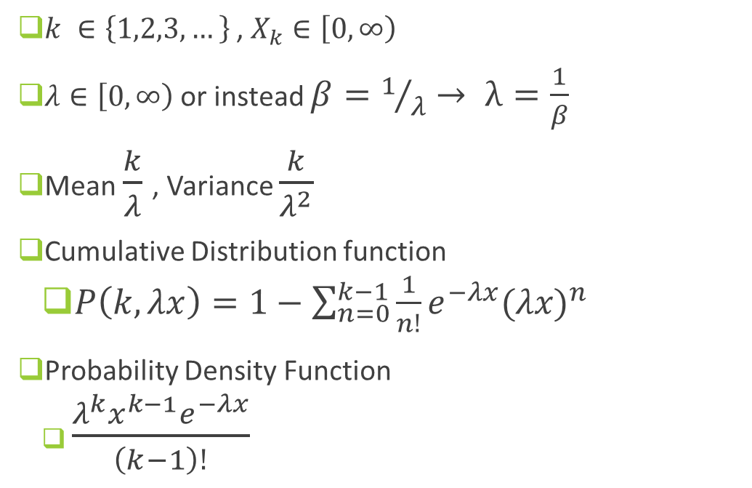
Erlang’s Distribution
$k ∈\left\{1,2,3,…\right\}$ , $X_{k}∈\left[0,∞\right)$
$λ∈\left[0,∞\right)$ or instead $β=1/λ→ λ=\frac{1}{β}$
Mean $\frac{k}{λ}$ , Variance $\frac{k}{λ^{2}}$
Cumulative Distribution function
  $P\left(k,λx\right)=1−\sum_{n=0}^{k−1}{\frac{1}{n!}e^{−λx}{(λx)}^{n}}$
Probability Density Function
  $\frac{λ^{k}x^{k−1}e^{−λx}}{\left(k−1\right)!}$
Probability Density Function
Mohammad Mahdi Manafi
Notes:
The Erlang distribution is the distribution of a sum of k independent exponential variables with mean 1/λ each: $\sum_{i=1}^{k}{x_{i}}$ , mean $x_{i}$ = 1/λ
Equivalently, it is the distribution of the time until the kth event of a Poisson process with a rate of λ.
The Erlang and Poisson distributions are complementary, in that while the Poisson distribution counts the events that occur in a fixed amount of time, the Erlang distribution counts the amount of time until the occurrence of a fixed number of events. When k=1, the distribution simplifies to the exponential distribution.

Slide 4
Introduction
Problem statement
  Reduce task drop probability (complete tasks before their deadlines)
  To maximize social welfare
    Need to balance both user (QoS) and provider perspectives (costs)
  Queuing theory analysis and optimization of edge-fog-cloud
Motivations
  Limitations of Pure Edge/Fog/Cloud Computing
    Unlimited resources in cloud and low latencies in edge and fog
  Only cloud or edge solutions are not sufficient (need for integrated)
  Lake of queuing theory analysis with reneging in previous works
Solution approach
  Markov queuing system model with reneging analysis
  computational resources allocation method is proposed
    Maximizing specific social welfare (optimization target)
Mohammad Mahdi Manafi
Notes:
QoS = drop , latency
This solution (EFC) enables massive improvements in system performance and users quality of service (QoS), introducing higher levels of flexibility for rapid computations and high mobility patterns. In this regards, the service providers point of view has to be considered, in order to provide a proper system resources exploitation. Towards this direction, the paper analyzes the performance of an integrated cloud-fog-edge computing infrastructure depicted in,
we have resorted here to a Markov queueing system model with reneging, to take into account the premature departure of a request due to the expiration of the associated deadline

Slide 5
Related works
Reference | approach | objectives
[14] | DRL | Minimize service time
[18] | Game theory | Resource allocation and offloading
[32] | M/G/infinite | Optimize number of processors
[34] | Algorithm | Energy and performance
Mohammad Mahdi Manafi

Slide 6
Related works
Reference | approach | objectives
[35] | Algorithm | Delay and performance
[36] | Queuing Analysis | Availability and performance
[39] | M/M/c/K | AVG of service time, performance, sharing resources
[30] | Fuzzy logic | Number of processors and maintaining costs
Mohammad Mahdi Manafi

Slide 7
System model

Slide 8
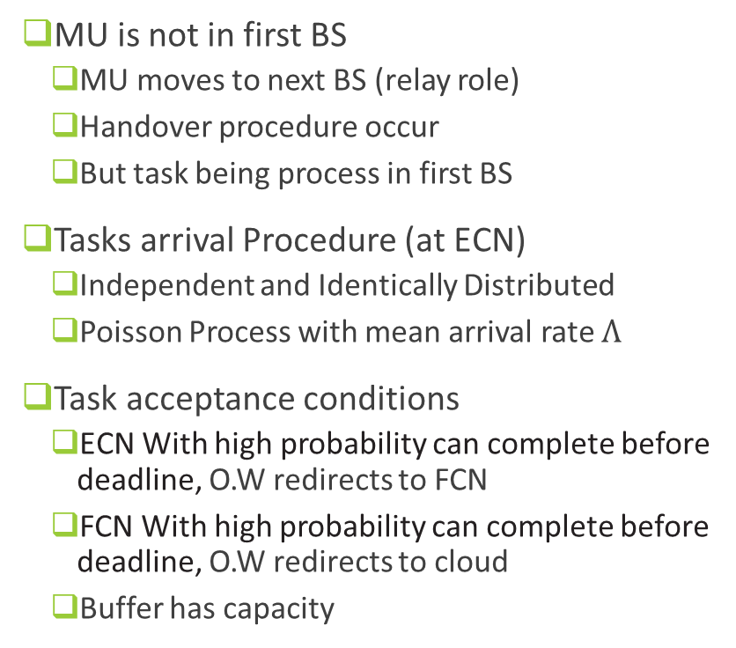
System model
System nodes
  Cloud, FCN, BS, ECN, mobile users (MU)
Edge computing (ECN), Fog computing (FCN)
  Markov queuing system with finite capacity
Cloud does not reject any tasks (reneging)
  Reneging due expiration of task deadline
Heterogenous Resources
BS (5G)
  Reliable , Low-latency, high speed
MU is not in first BS
  MU moves to next BS (relay role)
  Handover procedure occur
  But task being process in first BS
Tasks arrival Procedure (at ECN)
  Independent and Identically Distributed
  Poisson Process with mean arrival rate $Λ$
Task acceptance conditions
  ECN With high probability can complete before deadline, O.W redirects to FCN
  FCN With high probability can complete before deadline, O.W redirects to cloud
  Buffer has capacity
Mohammad Mahdi Manafi

Slide 9
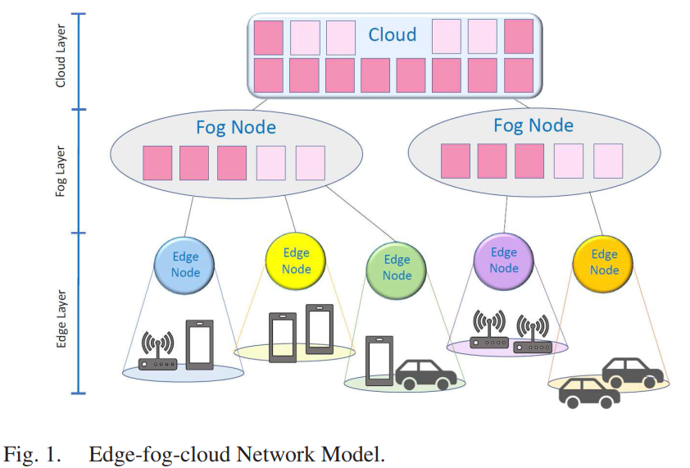
cloud
FCN
ECN
ECN
Tasks
Tasks
Data Flow
Mohammad Mahdi Manafi

Slide 10
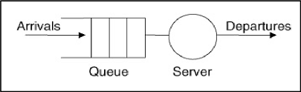
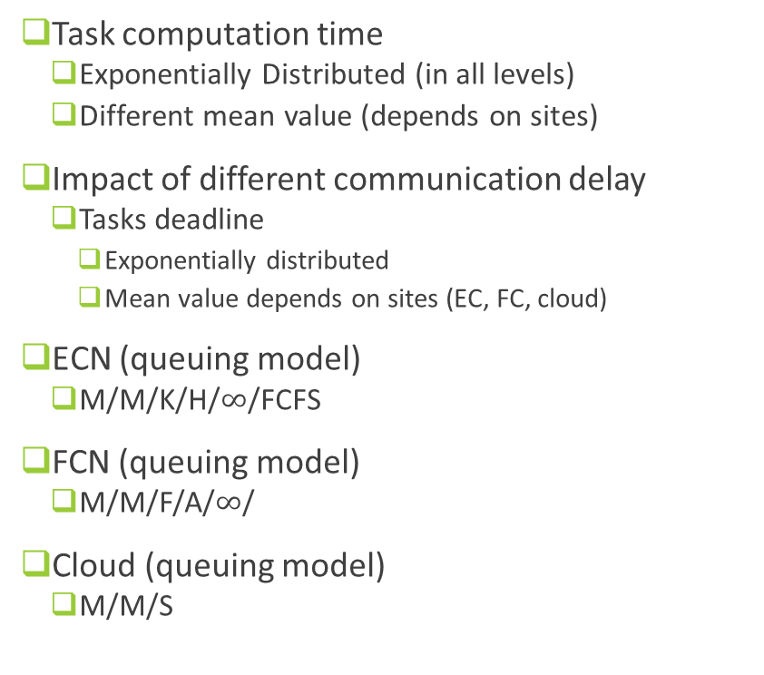
System model
Task computation time
  Exponentially Distributed (in all levels)
  Different mean value (depends on sites)
Impact of different communication delay
  Tasks deadline
    Exponentially distributed
    Mean value depends on sites (EC, FC, cloud)
ECN (queuing model)
  M/M/K/H/$∞$/FCFS
FCN (queuing model)
  M/M/F/A/$∞$/
Cloud (queuing model)
  M/M/S
1
H
Queue
2
K
Mohammad Mahdi Manafi
Notes:
K, H, F, A, S have to be derived with suitable optimization approach based on QoS Requirements
Note: It is important to note that at both the ECNs and FCNs, the task computation completion is assumed guaranteed, since any new arrived task computation request is admitted if this is assured with a suitable probability, as detailed later.

Slide 11

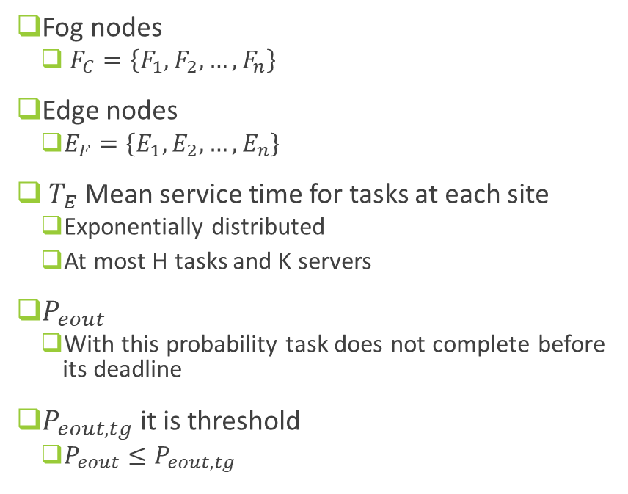

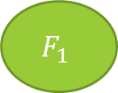
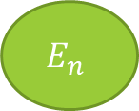
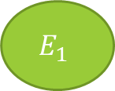

System model
Fog nodes
  $F_{C}=\left\{F_{1},F_{2}, …,F_{n}\right\}$
Edge nodes
  $E_{F}=\left\{E_{1},E_{2},…,E_{n}\right\}$
$T_{E}$Mean service time for tasks at each site
  Exponentially distributed
  At most H tasks and K servers
$P_{eout}$
  With this probability task does not complete before its deadline
$P_{eout,tg}$ it is threshold
  $P_{eout}≤P_{eout,tg}$
C
$$E_{i}$$
$${ECN}_{1}$$
$${ECN}_{n}$$
$$F_{1}$$
BS
$$E_{1}$$
$$E_{n}$$
Wireless
Negligible Latency
Tasks
Tasks
Tasks
Mohammad Mahdi Manafi
Notes:
H is chosen as the largest queue length such that $P_{eout}≤P_{eout,tg}$.
If queue length is small → tasks usually meet deadlines.
As queue gets longer → risk of missing deadlines increases.
We want to find the longest queue we can allow while still keeping the late-task risk below an acceptable level.
Hence, given K and PEOUT , the maximum number H of task computation requests accepted by each ECN is derived under the assumption (worst case) that each task computation request accepted by ECN completes service within its deadline

Slide 12
Edge subsystem analysis
Section 1

Slide 13
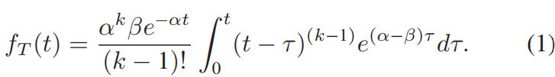
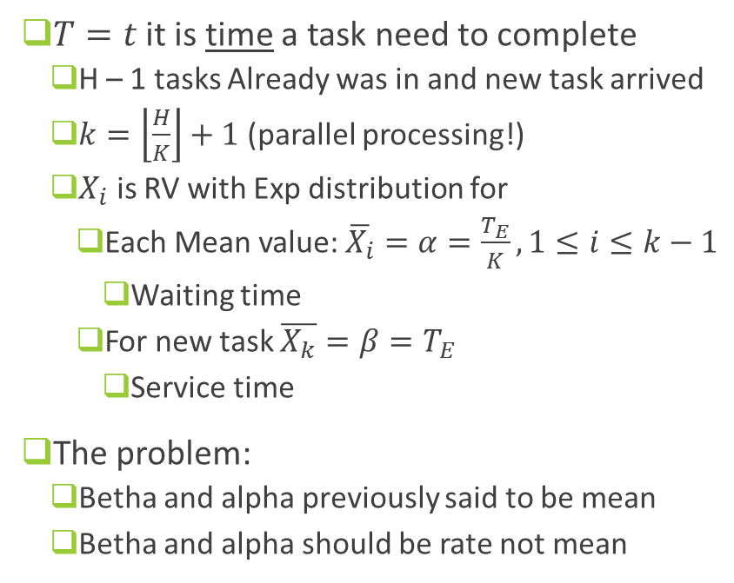
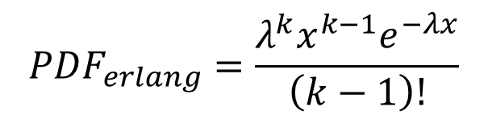
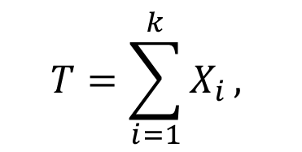
Edge subsystem analysis
$T=t$ it is time a task need to complete
  H – 1 tasks Already was in and new task arrived
  $k=\left\lfloor \frac{H}{K}\right\rfloor +1$ (parallel processing!)
  $X_{i}$ is RV with Exp distribution for
    Each Mean value: $\overline{X_{i}}=α=\frac{T_{E}}{K}, 1≤i≤k−1$
      Waiting time
    For new task $\overline{X_{k}}=β=T_{E}$
      Service time
The problem:
  Betha and alpha previously said to be mean
  Betha and alpha should be rate not mean
$$T=\sum_{i=1}^{k}{X_{i}},$$
$${PDF}_{erlang}=\frac{λ^{k}x^{k−1}e^{−λx}}{\left(k−1\right)!}$$
PDF of T (Erlang Distribution)
Mohammad Mahdi Manafi
Notes:
It follows that the time needed to a task computation request arrived while in the ECN there are H - 1 requests to complete its service,
i.e., T ,
Therefore, the pdf of T can be obtained throughout the convolution of an Erlang distribution generating the random variable corresponding to the sum of the k independent exponential random variables previously introduced, and the exponential distribution with mean values β.
The authors are approximating the completion time of a task arriving when the system already contains H−1 jobs.
Since service times are exponential and there are K servers working in parallel, the waiting component becomes Erlang distributed. The final service of the task itself contributes one more exponential term.

Slide 14
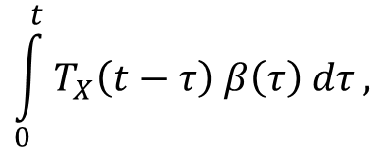
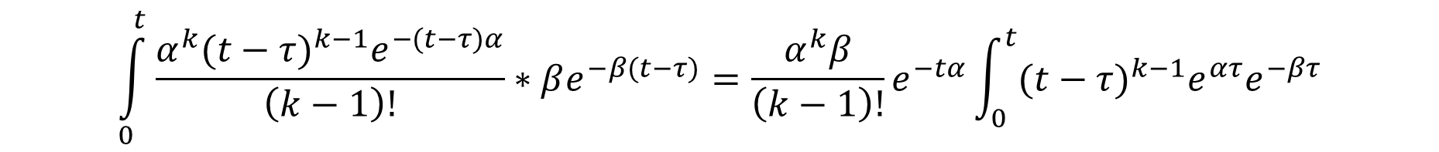

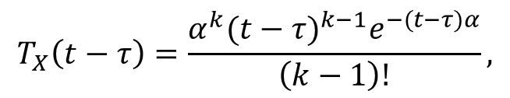
How PDF derived
$$\int_{0}^{t}{T_{X}\left(t−τ\right) β\left(τ\right) dτ},$$
$$T_{X}\left(t−τ\right)=\frac{{α^{k}(t−τ)}^{k−1}e^{−(t−τ)α}}{\left(k−1\right)!},$$
Convolution:
$$β\left(τ\right)=λe^{−λ(τ)}=βe^{−β(τ)}$$
$$\int_{0}^{t}{\frac{{α^{k}(t−τ)}^{k−1}e^{−(t−τ)α}}{\left(k−1\right)!}∗βe^{−β(t−τ)}}=\frac{α^{k}β}{\left(k−1\right)!}e^{−tα}\int_{0}^{t}{{(t−τ)}^{k−1}{e^{ατ}e}^{−βτ}}$$
Mohammad Mahdi Manafi

Slide 15
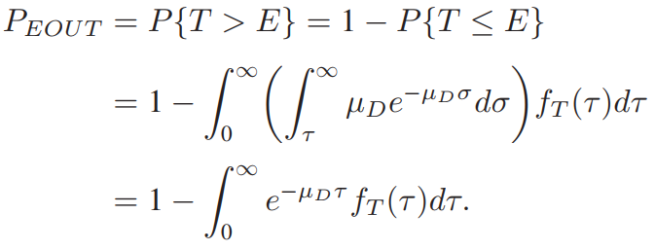
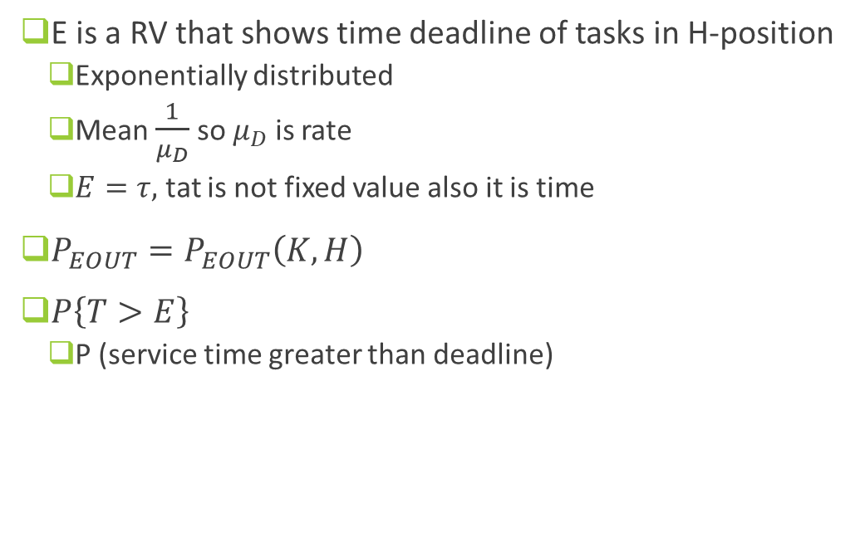
Edge subsystem analysis
E is a RV that shows time deadline of tasks in H-position
  Exponentially distributed
  Mean $\frac{1}{μ_{D}}$ so $μ_{D}$ is rate
  $E=τ,$ tat is not fixed value also it is time
$P_{EOUT}=P_{EOUT}\left(K,H\right)$
$P\left\{T>E\right\}$
  P (service time greater than deadline)
(2)
Mohammad Mahdi Manafi

Slide 16
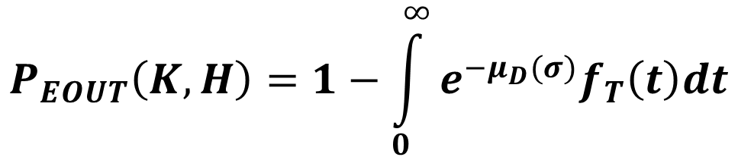

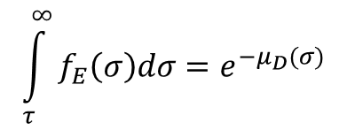
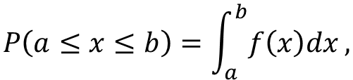
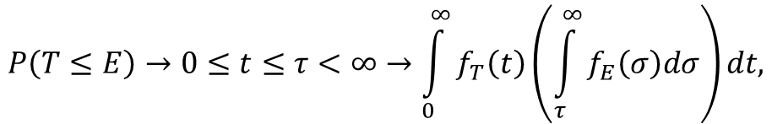
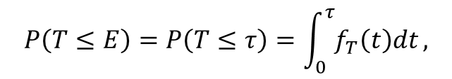
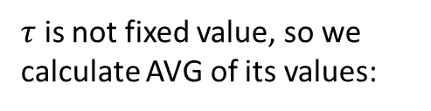

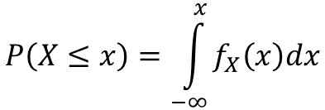
How PDF derived
Remember:
$$f_{E}(σ)=μ_{D}e^{−μ_{D}(σ)}$$
$$P\left(a≤x≤b\right)=\int_{a}^{b}{f\left(x\right)dx},$$
$$P\left(T≤E\right)→0≤t≤τ<∞→\int_{0}^{∞}{f_{T}\left(t\right)\left(\int_{τ}^{∞}{f_{E}\left(σ\right)dσ}\right)}dt,$$
$$P\left(X≤x\right)=\int_{−∞}^{x}{f_{X}\left(x\right)dx}$$
$$\int_{τ}^{∞}{f_{E}\left(σ\right)dσ}=e^{−μ_{D}(σ)}$$
$$P\left(T≤E\right)=P\left(T≤τ\right)=\int_{0}^{τ}{f_{T}\left(t\right)dt},$$
$τ$ is not fixed value, so we calculate AVG of its values:
$$P_{EOUT}\left(K,H\right)=1−\int_{0}^{∞}{e^{−μ_{D}(σ)}f_{T}\left(t\right)dt}$$
$$P\left(T≤E\right)=\int_{0}^{∞}{P\left(T≤τ\right)f\left(τ\right)dτ},$$
Mohammad Mahdi Manafi

Slide 17

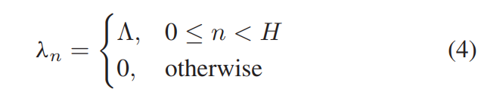
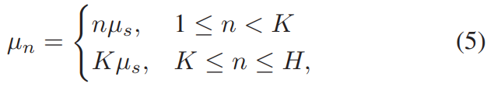
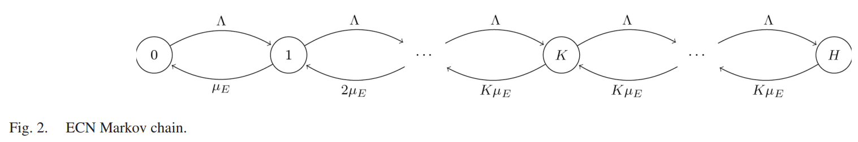

Edge subsystem analysis
Choosing K and H should satisfy (3)
Any task arrived after ECN is in state H
  i.e. queue is full
  Redirect to FCN
Fig2 is state diagram of the M/M/K/H
${\overline{μ}}_{s}=\frac{1}{μ_{s}}=μ_{E}$, n: number of states
Mohammad Mahdi Manafi

Slide 18


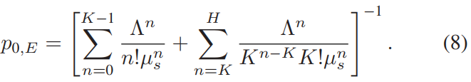

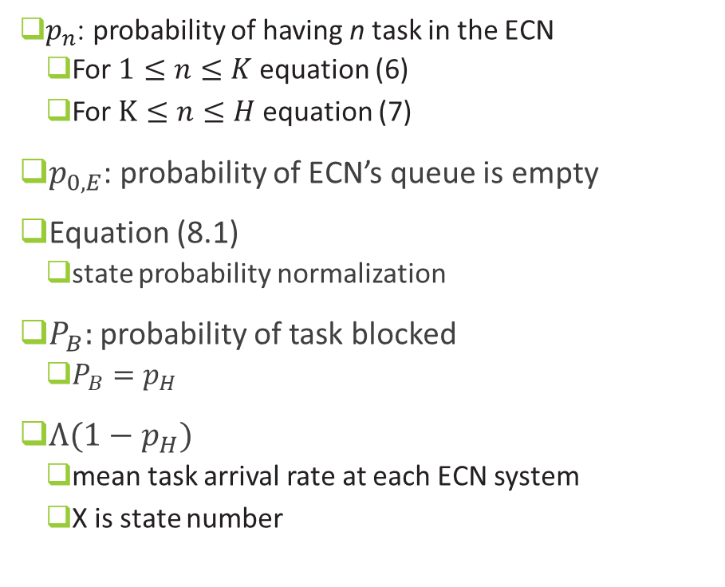
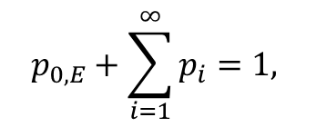
Edge subsystem analysis
$p_{n}$: probability of having n task in the ECN
  For $1≤n≤K$ equation (6)
  For $K≤n≤H$ equation (7)
$p_{0,E}$: probability of ECN’s queue is empty
Equation (8.1)
  state probability normalization
$P_{B}:$ probability of task blocked
  $P_{B}=p_{H}$
$Λ(1−p_{H})$
  mean task arrival rate at each ECN system
  X is state number
$$p_{0,E}+\sum_{i=1}^{∞}{p_{i}}=1,$$
(8.1)
Mohammad Mahdi Manafi

Slide 19
Fog subsystem analysis
Section 2

Slide 20
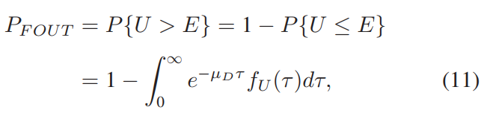

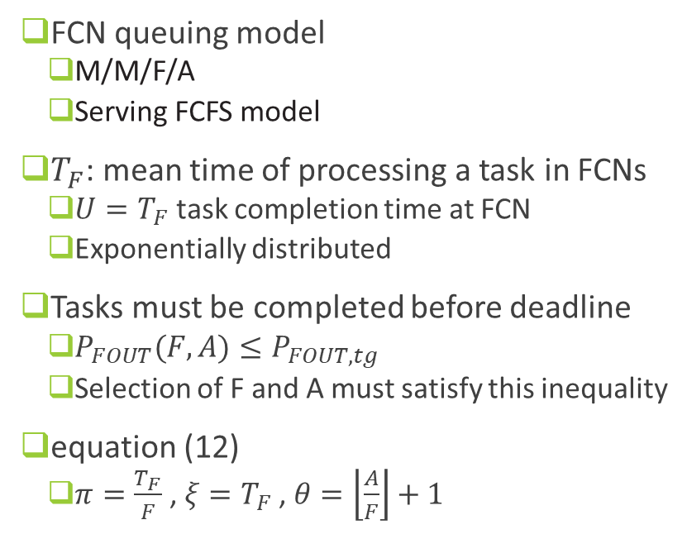
Fog subsystem analysis
FCN queuing model
  M/M/F/A
  Serving FCFS model
$T_{F}$: mean time of processing a task in FCNs
  $U=T_{F}$ task completion time at FCN
  Exponentially distributed
Tasks must be completed before deadline
  $P_{FOUT}(F,A)≤P_{FOUT,tg}$
  Selection of F and A must satisfy this inequality
equation (12)
  $π=\frac{T_{F}}{F}$ , $ξ=T_{F}$ , $θ=\left\lfloor \frac{A}{F}\right\rfloor +1$
Mohammad Mahdi Manafi

Slide 21
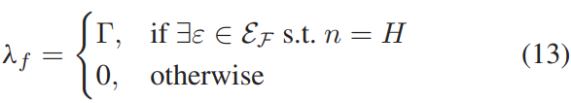

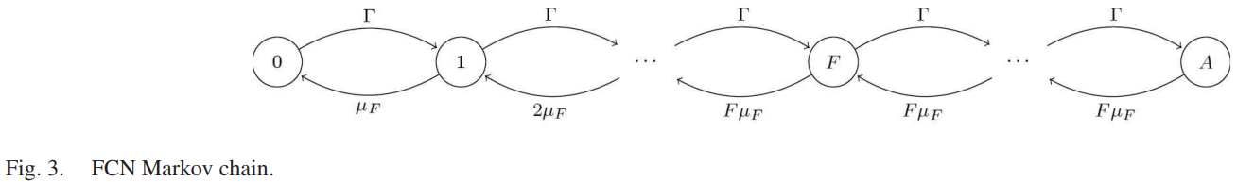
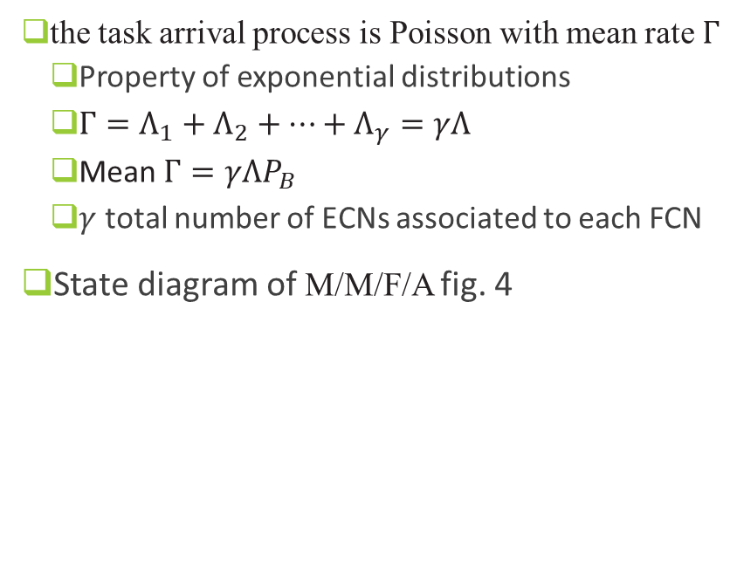
Fog subsystem analysis
the task arrival process is Poisson with mean rate $Γ$
  Property of exponential distributions
  $Γ=Λ_{1}+Λ_{2}+…+Λ_{γ}=γΛ$
  Mean $Γ=γΛP_{B}$
  $γ$ total number of ECNs associated to each FCN
State diagram of M/M/F/A fig. 4
Mohammad Mahdi Manafi

Slide 22

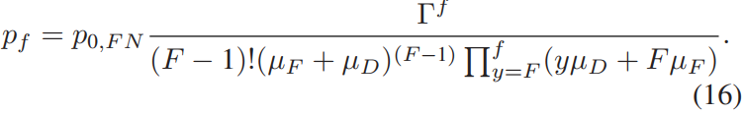
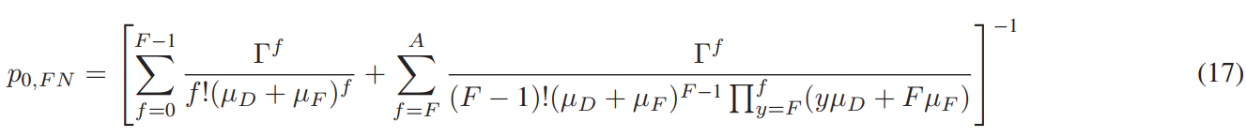
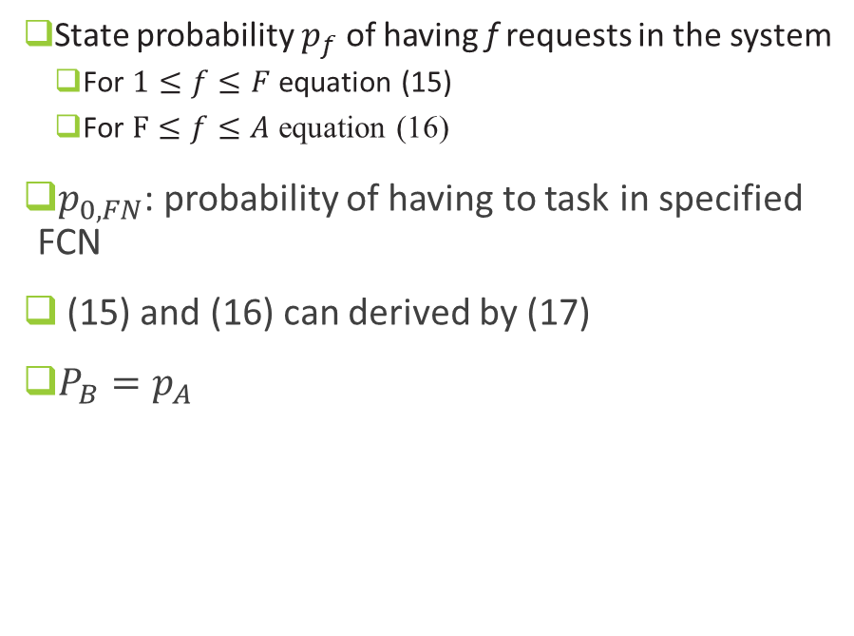
Fog subsystem analysis
State probability $p_{f}$ of having f requests in the system
  For $1≤f≤F$ equation (15)
  For $F≤f≤A$ equation (16)
$p_{0,FN}$: probability of having to task in specified FCN
(15) and (16) can derived by (17)
$P_{B}=p_{A}$
Mohammad Mahdi Manafi

Slide 23

Fog subsystem analysis
Mean time spent by each task in a FCN through the Little’s formula equation (18)
(18)
Mohammad Mahdi Manafi

Slide 24
Cloud subsystem analysis
Section 3

Slide 25
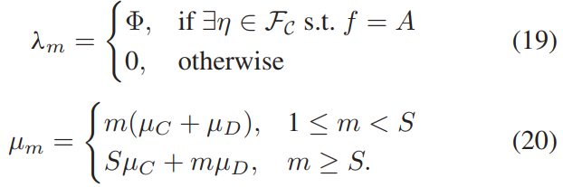
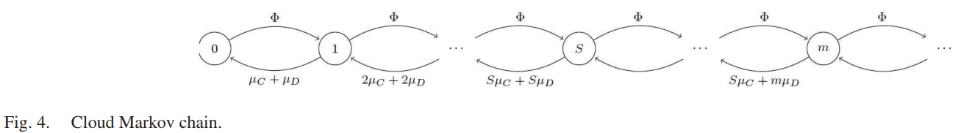
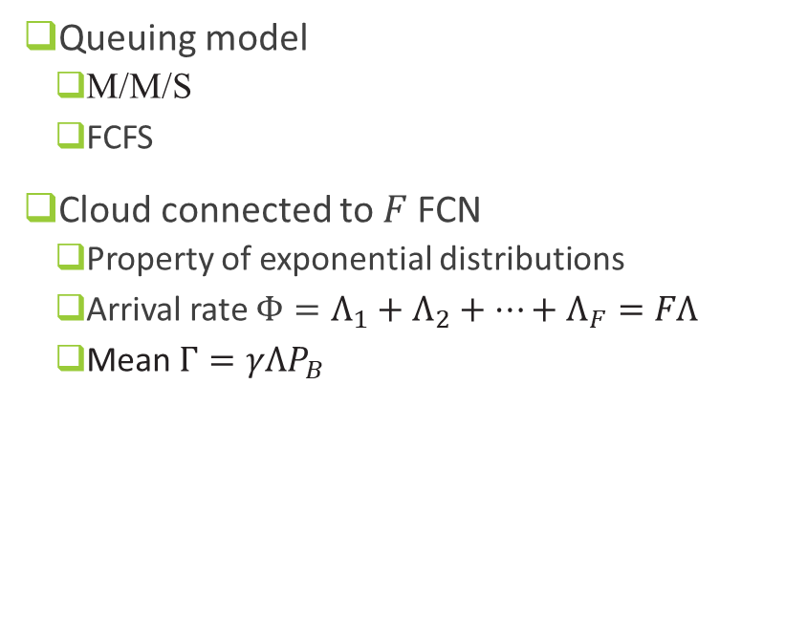
Cloud subsystem analysis
Queuing model
  M/M/S
  FCFS
Cloud connected to $F$FCN
  Property of exponential distributions
  Arrival rate $Φ=Λ_{1}+Λ_{2}+…+Λ_{F}=FΛ$
  Mean $Γ=γΛP_{B}$
Mohammad Mahdi Manafi

Slide 26

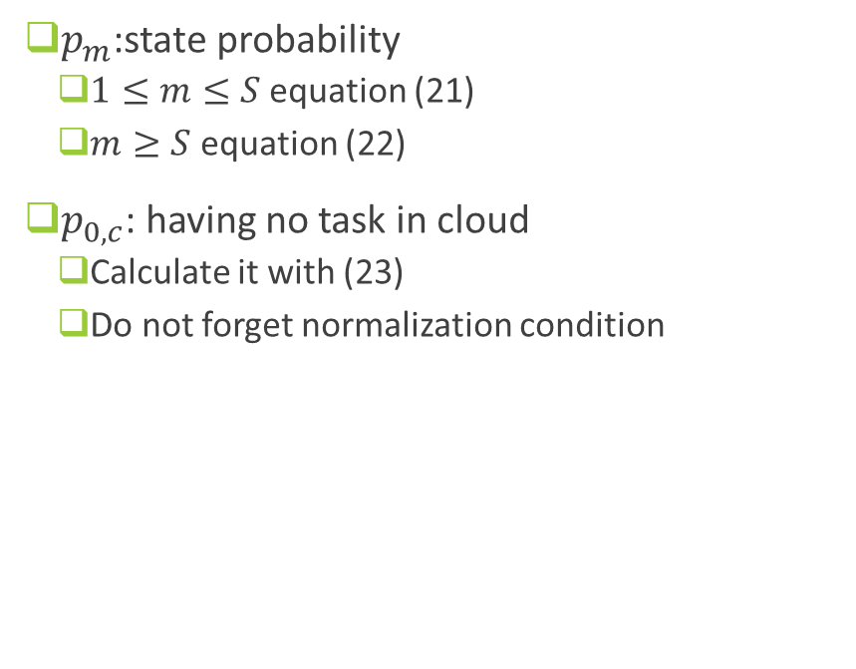
Cloud subsystem analysis
$p_{m}$:state probability
  $1≤m≤S$ equation (21)
  $m≥S$ equation (22)
$p_{0,c}$: having no task in cloud
  Calculate it with (23)
  Do not forget normalization condition
(22)
(23)
Mohammad Mahdi Manafi

Slide 27


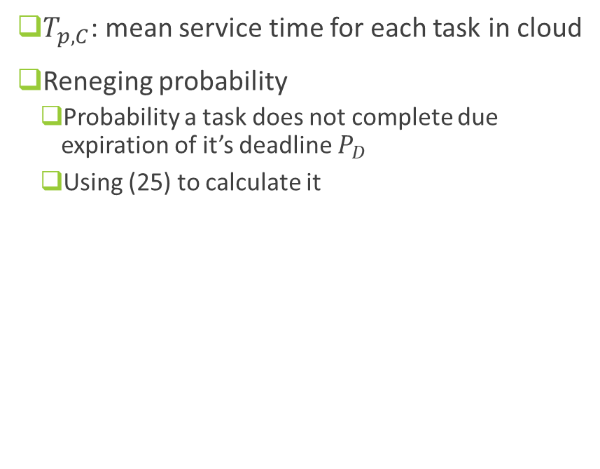
Cloud subsystem analysis
$T_{p,C}$: mean service time for each task in cloud
Reneging probability
  Probability a task does not complete due expiration of it’s deadline $P_{D}$
  Using (25) to calculate it
(24)
(25)
Mohammad Mahdi Manafi

Slide 28
Problem formulation

Slide 29
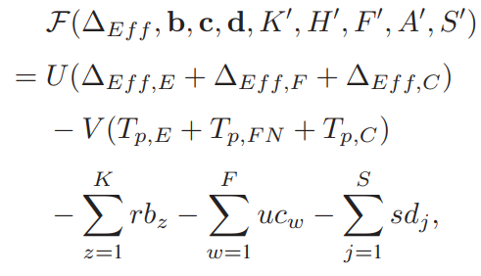
Problem formulation
Optimization
  Derive the proper number of active processors for each ECN, FCN and cloud
  Maximum number of tasks accepted by each ECN and FCN
  Maximization of the social welfare
    Consider both the users and provider perspective
Objective function (26)
  social welfare function
  What should K, F, S, H, A be?
  What is trade off?
    More CPU more cost for provider
    More CPU more better performance for user
(26)
Mohammad Mahdi Manafi

Slide 30
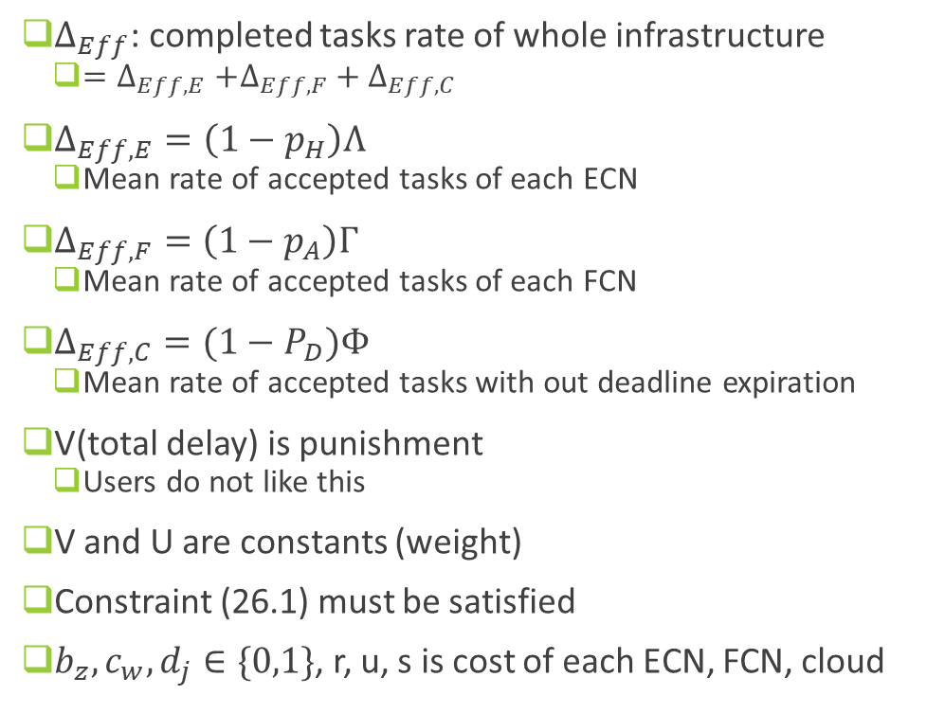
Problem formulation
$Δ_{Eff}$: completed tasks rate of whole infrastructure
  ${=Δ}_{Eff,E}+Δ_{Eff,F}+Δ_{Eff,C}$
$Δ_{Eff,E}=\left(1−p_{H}\right)Λ$
  Mean rate of accepted tasks of each ECN
$Δ_{Eff,F}=\left(1−p_{A}\right)Γ$
  Mean rate of accepted tasks of each FCN
$Δ_{Eff,C}=(1−P_{D})Φ$
  Mean rate of accepted tasks with out deadline expiration
V(total delay) is punishment
  Users do not like this
V and U are constants (weight)
Constraint (26.1) must be satisfied
$b_{z},c_{w},d_{j}∈\{0,1\}$, r, u, s is cost of each ECN, FCN, cloud
(26)
$$K^{′}≤K, H^{′}≤H, F^{′}≤F, A^{′}≤A, S^{′}≤S$$
(26.1)
Mohammad Mahdi Manafi

Slide 31
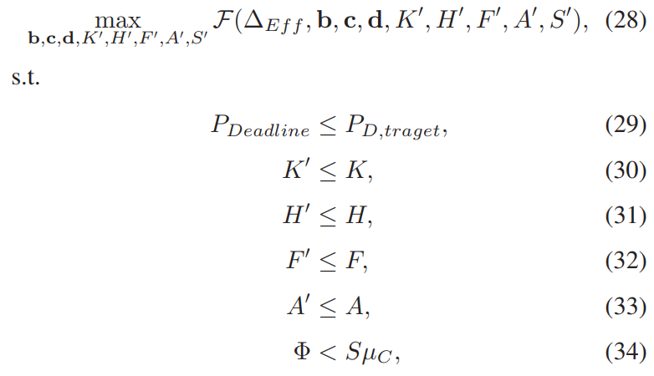
Problem formulation
Final and formal form of objective function
Mohammad Mahdi Manafi

Slide 32
Proposed Heuristic

Slide 33
Proposed Heuristic
Approximated heuristic to determine the suitable number of CPUs to be allocated at each computation site
Maximum number of accepted tasks at each ECN and FCN in order to guarantee a specific QoS
Proposed procedure is iterative
Mohammad Mahdi Manafi

Slide 34
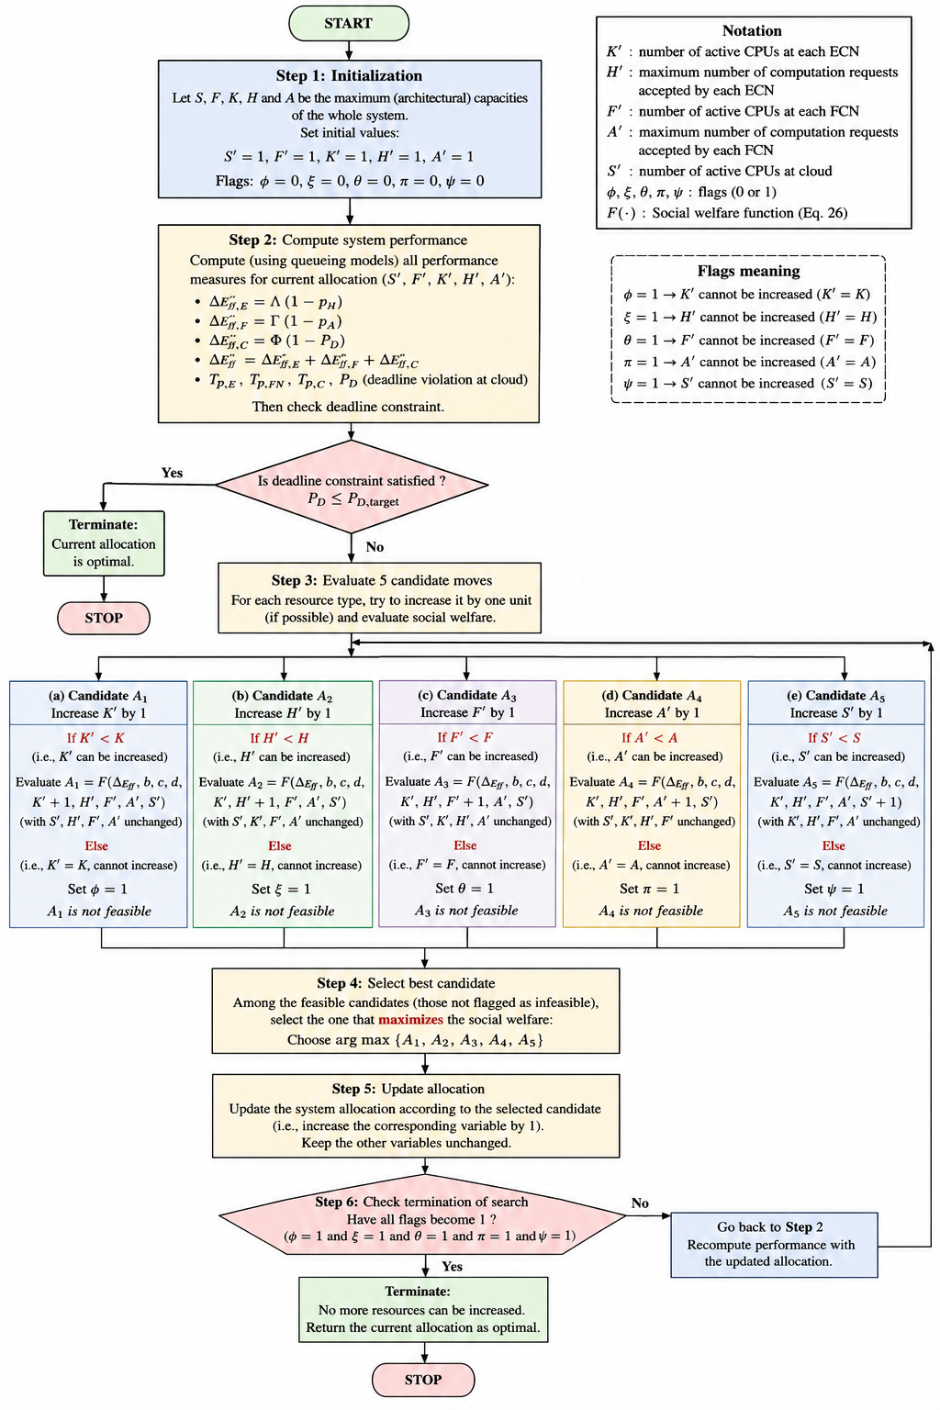

Slide 35
Numerical results

Slide 36

Setup
Analytical results (AR)
  From their Markov queueing models.
Numerical results (SR)
  Monte Carlo simulations
  2000 iteration
Deliberately violate some of the Markov assumptions
  Arrivals: Normal distribution
  Service times: Hyperexponential distribution
  also Weibull distribution
  If the analytical model still matches simulation, then the queueing approximation is robust.
Mohammad Mahdi Manafi

Slide 37


System parameters
 | Edge (each node) | Fog (each node) | Cloud
CPUs | K = 14 | F = 13 | S = 16
Node count | 6 | 3 | 1
Mean service time | $T_{E}={E[μ}_{E}]=$ 0.1s | $T_{FC}={E[μ}_{F}]=$ 0.2s | ${T_{C}=E[μ}_{C}]=$ 0.4s
Rate (job per sec) | $$μ_{E}=10$$ | $$μ_{F}=5$$ | $$μ_{C}=2.5$$
Cloud speed < Fog speed < Edge speed
This is because of Simplicity and execution delay only not communication
Why cloud is still useful? Because cloud has more CPU (16 * 2.5)
Only reason to redirect a task is queue is full
Also Paper wants to:
$$P_{OUT}≤3∗{10}^{−3} at all layers$$
Mohammad Mahdi Manafi

Slide 38

Block probability in ECN
When rate increase probability increase
  Because queue is finite
  CPU power decrease
  Thus blocking increase
  Analytical and simulation curves almost overlap
    This validates the Edge queueing model.
Mohammad Mahdi Manafi

Slide 39

Block probability in FCN
When rate increase probability increase
  Because queue is finite
  CPU power decrease
  Thus blocking increase
  Analytical predictions and simulation curves overlap
    This validates the Edge queueing model.
The Markov queueing model predicts performance very accurately even though the simulation uses non-exponential distribution
Mohammad Mahdi Manafi

Slide 40


Objective function
Parameters
  V = 4 , U = 15, r = 20, u = 16, s = 12
The function increased with traffic load increase
Because
  U($Δ_{Eff}$) grows faster than the increase in costs.
  More users are being served
  More revenue is generated
The heuristic succeeds in exploiting additional resources efficiently as demand increases
Mohammad Mahdi Manafi

Slide 41

Optimal H and A
Admission thresholds
  Edge (H) and Fog (A)
  As load increase thresholds increase
Why?
  Larger queue more tasks accepted
  Thus throughput increase
Therefore the heuristic enlarges the admission limits
Mohammad Mahdi Manafi

Slide 42

Optimal Number of CPUs
Reporting
  K , F, S
As traffic increase
  K, F, S also increase
The growth is not linear
Optimizer only activates additional CPUs when the Obj func gain, exceeds the activation cost
This is expected because
  More jobs arrive
  Thus, more servers are needed to keep delays under control
Mohammad Mahdi Manafi

Slide 43


Deadline violation probability
Mohammad Mahdi Manafi

Slide 44

Deadline violation probability
The heuristic approach keeps the violation probability below the target.
when load increases then the algorithm activates additional resources, thus deadline guarantees are maintained
Mohammad Mahdi Manafi

Slide 45

Conclusion
Analytical model accuracy
  Queuing model approximations predict performance very closely
Heuristic behavior is sensible
QoS constraints are satisfied
  The deadline violation probability remains below the target
    $P_{OUT}≤3∗{10}^{−3}$
Mohammad Mahdi Manafi

Slide 46
References
Romano Fantacci, Benedetta Picano, “Performance Analysis of a Delay Constrained Data Offloading Scheme in an Integrated Cloud-Fog-Edge Computing System ”, IEEE TRANSACTIONS ON VEHICULAR TECHNOLOGY, VOL. 69, NO. 10, OCTOBER 2020.

Slide 47
The end

